Slide 1
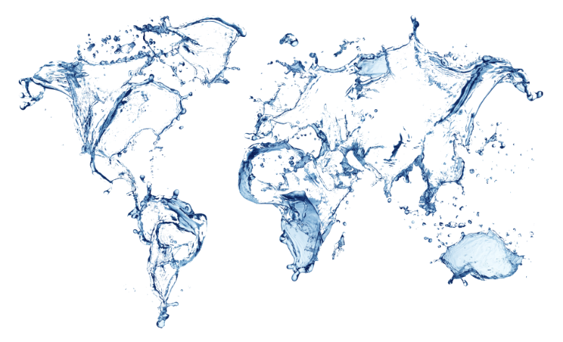
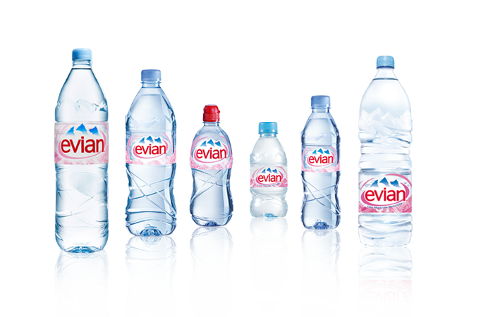

Food company
Sarah GASTALDO Léa HARMEL
19/03/2018

Slide 2
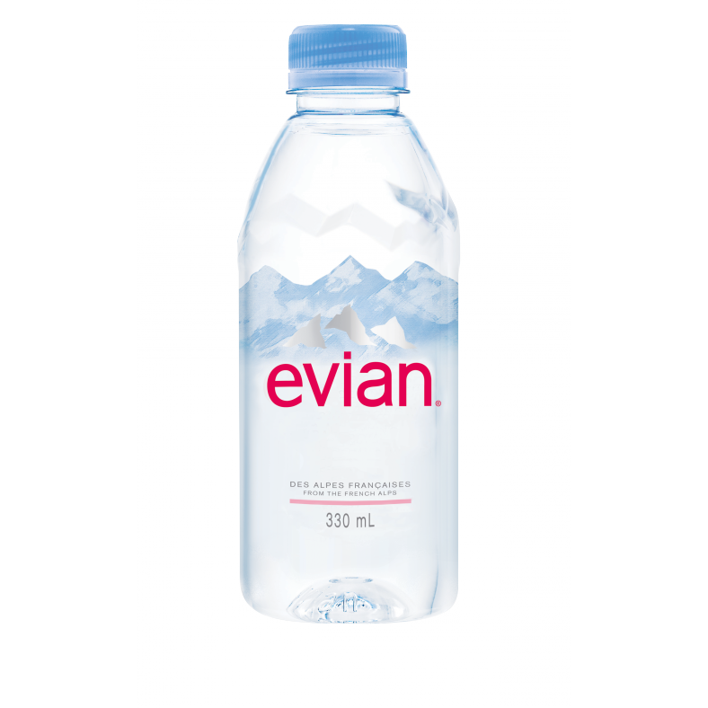
Plan
I) Introduction
II) A Brief History
1) Discovery of the source
2) Timeline of the company
III) Organisation and Structure
1) Geographical presence
2) Number of employees
3) Economic indicators
4) Communication
IV) From the water to the bottle
V) Water composition
VI) Product range
Everyday
Special Occasions
Evian Fruits and Plants
Evian Infused x Kusmi
Facial Spray
VII) Life cycle of an Evian bottle
VIII) Environment
IX) Conclusion

Slide 3

I) Introduction
“Food company: Company that processes and sells food.” (The free dictionary)
Average adult looses around 2.5 litres of water
Essential to stay hydrated
You can survive: - 40 days without food - 2 days without water
Evian owned by Danone
French company
Worldwide famous

Slide 4
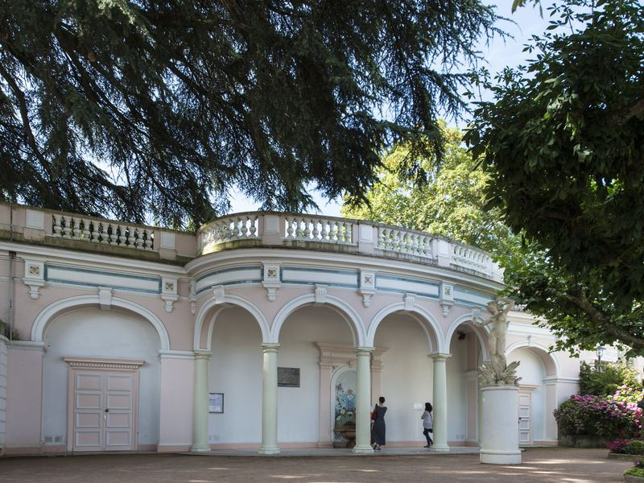
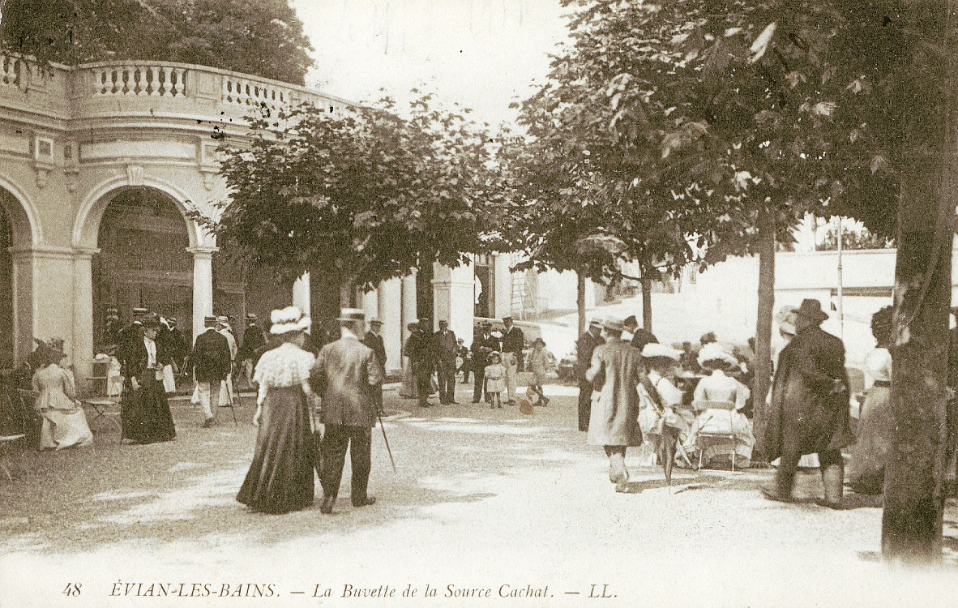
II) A Brief History
1) Discovery of the source
1789
Water had positive effect on health
Mr. Cachat began selling water
Evian = perfect water and health

Slide 5
II) A Brief History
2) Timeline of the company
1789 : The health problems of the Marquis de Lessert were cured by Evian water.
1878 : The French Academy of Medicine recognized the benefits of Evian water.
1962 : Launch of the first Evian facial spray.
1999 : Creation of the Evian Centre for water
1824 : Water is used for drinking and bathing in “cures”.
1935 : Evian focused on water for babies
1995 : Bottles: from PVC to PET.
Since 2000 Regular launch of different limited edition designed bottles.

Slide 6
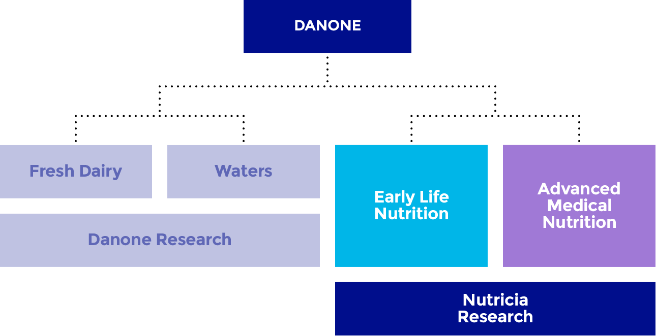
III) Organisation and Structure

Slide 7
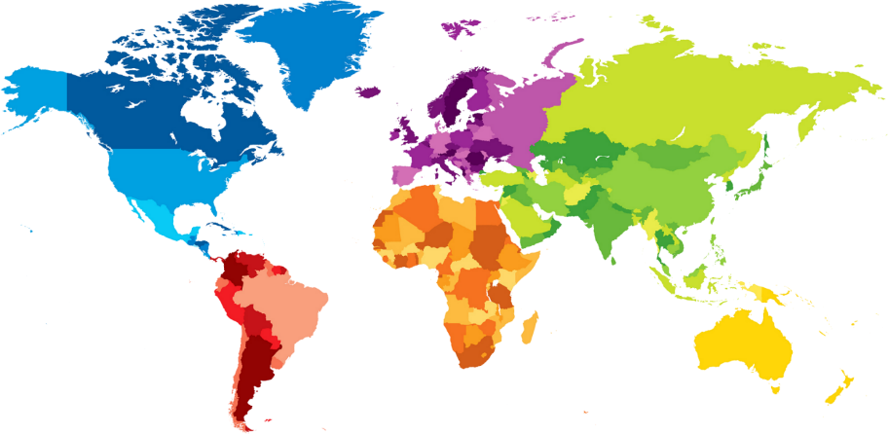
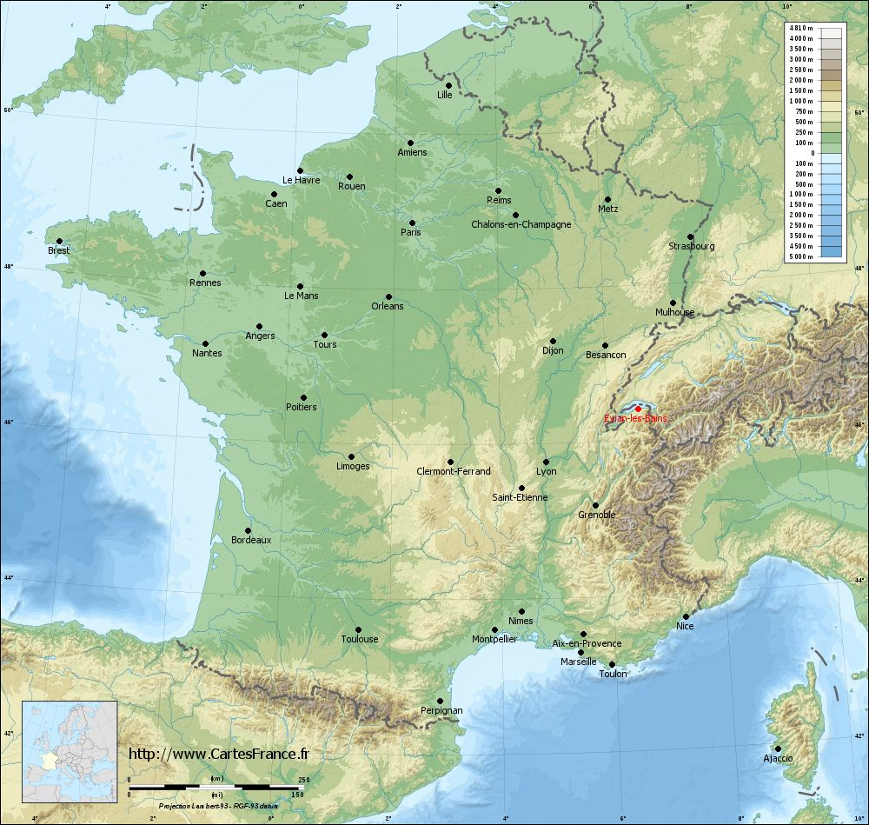
III) Organisation and Structure
1) Geographical presence
5 continents
150 countries
Mostly sold in France, Belgium, UK, Switzerland

Slide 8
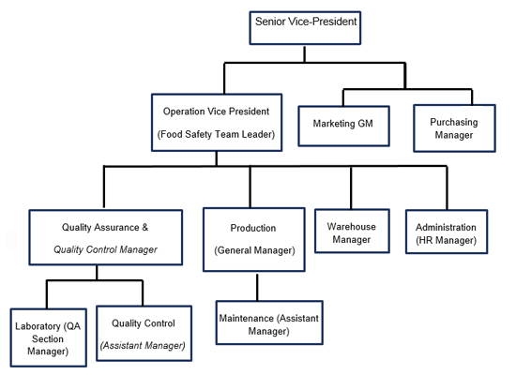
III) Organisation and Structure
2) Number of employees
2072 employees
Hard to get the org chart because it is a subsidiary of Danone.

Slide 9
III) Organisation and Structure
3) Economic indicators
N°2 worldwide in bottle water volume
2,2 billion bottles per year
6 million bottles per day
1,5 billion liter of water bottled per day
18% of the French still water market
Turnover > 1,5 billion Euros in 2016

Slide 10
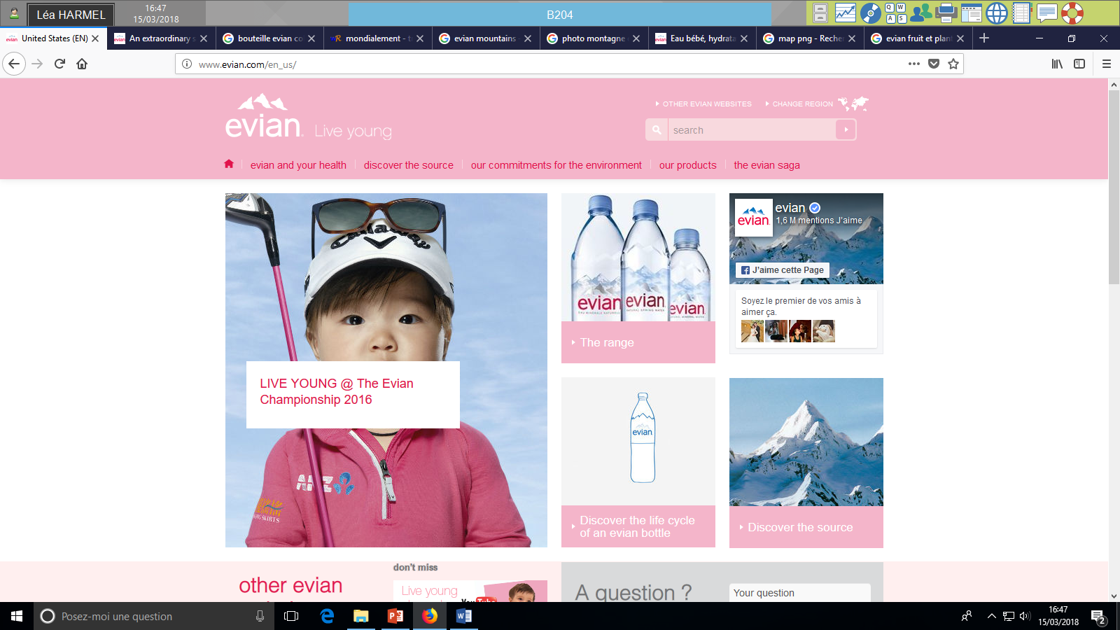
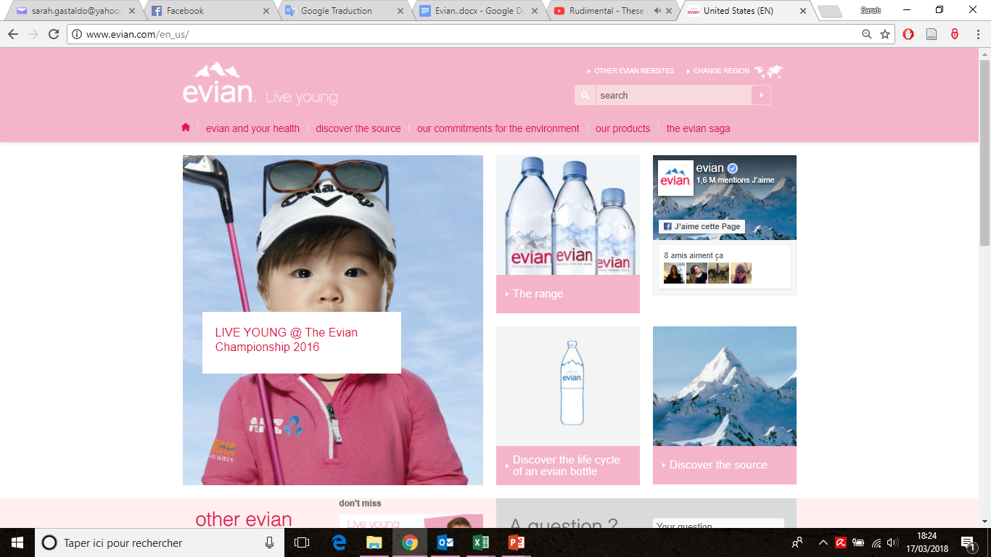
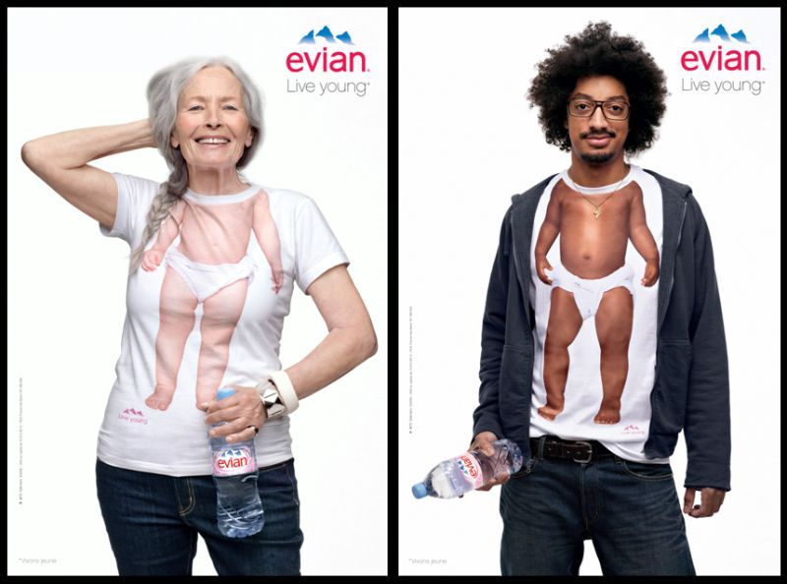

III) Organisation and Structure
4) Communication

Slide 11


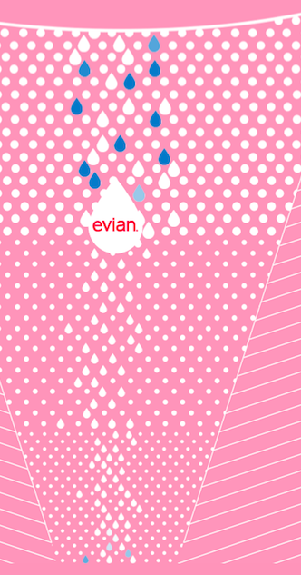
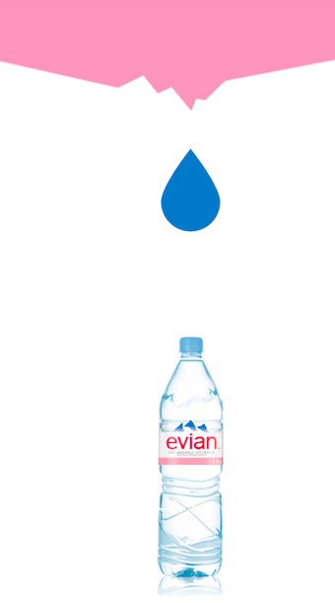
IV) From the water to the bottle
Water from
the rain and the melting snow.
15% of this water is going to
infiltrate in the ground
The water is percolating in the ground, taking 15 years to get to the source
A pure water emerges on the sides of the Alps
Youtube video : https://www.youtube.com/watch?v=kzhiO9KqNvM

Slide 12
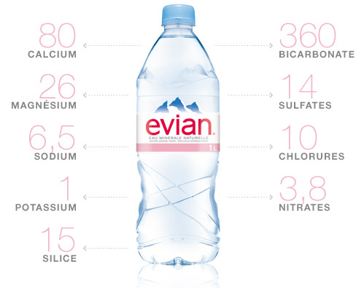
V) Water composition
pH= 7,2
Can be drunk daily
Recommended for everyone, and especially for: - Babies - Pregnant women - Breastfeeding women
SILICA
Total content in mineral salts. In mg/litre

Slide 13
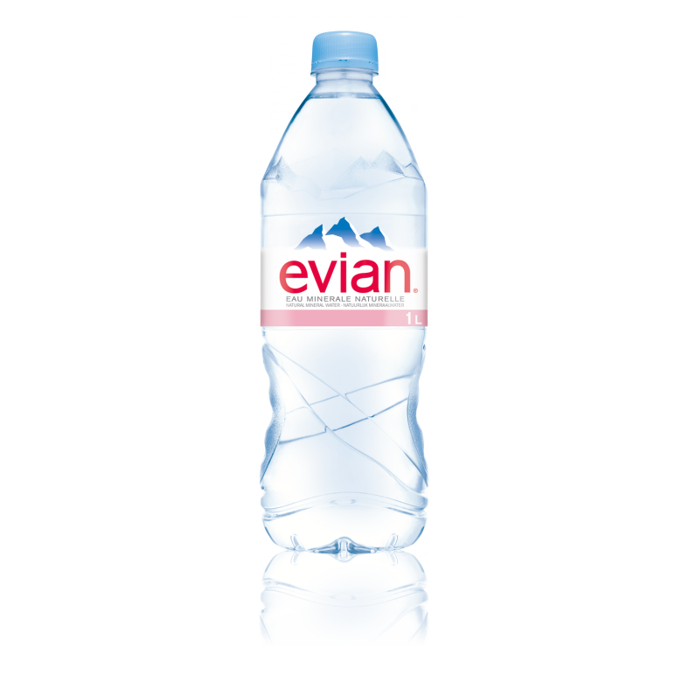
VI) Product range
1) Everyday
33 cl
50 cl
75 cl
1 litre
1.5 litre

Slide 14
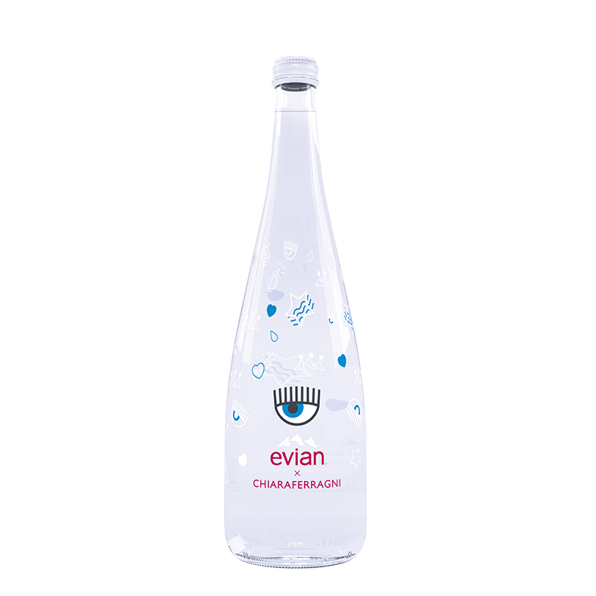
VI) Product range
Glass bottles
Limited editions
Designed by: -Chiara Ferragni -Christian Lacroix -Paul Smith -…
2) Special occasions
2000

Slide 15
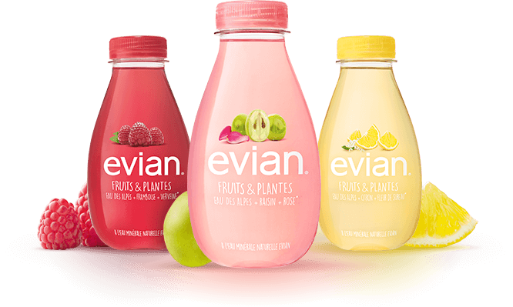
VI) Product range
3)Evian fruits and plants
2016
Water, fruits and botanicals
3 recipes: raspberry and verbena, lemon and elderflower, grape and rose
84% Evian water
16% Fruit juice and plant extracts
No sweetener, no food colouring, no preservative

Slide 16

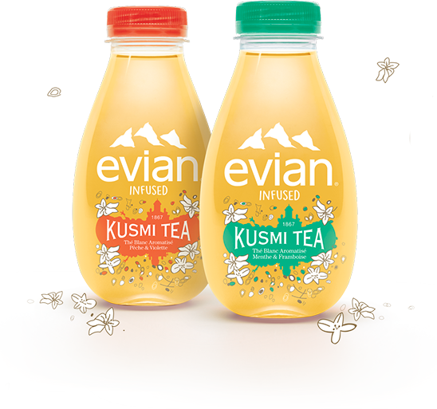
VI) Product range
4) Evian infused x Kusmi
2017
96% Evian water
3% Organic cane sugar
1% White tea infusion, mint and raspberry or peach and violet

Slide 17
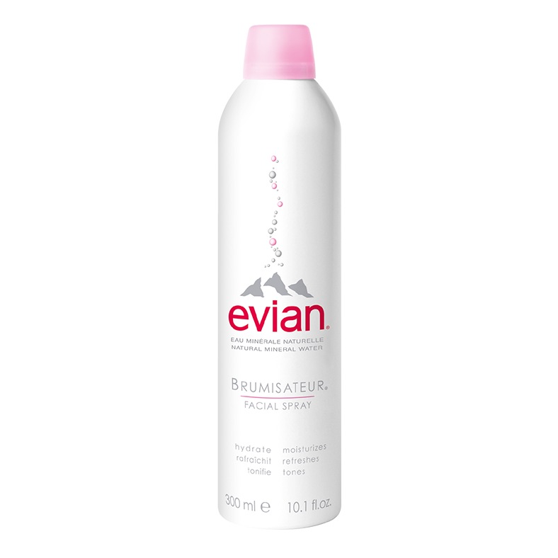
VI) Product range
5) Facial spray
Millions of tiny micro-droplets
Natural nitrogen
To cool down
Four sizes

Slide 18
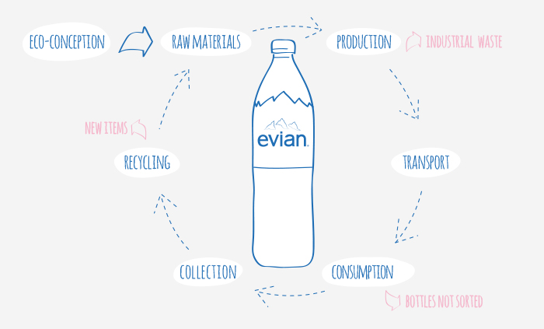
VII) Life cycle of an Evian bottle

Slide 19
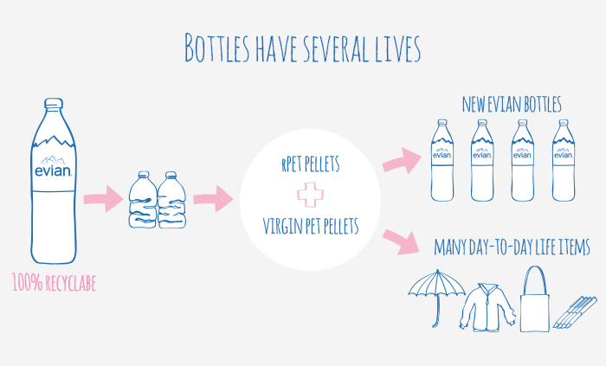
VIII) Environment
Transformed, the Evian bottles can become other objects or new bottles
Today only 1/2 bottles are recycled in average and only 1/5 in large cities.
Sorting is essential to reduce our environmental impact

Slide 20
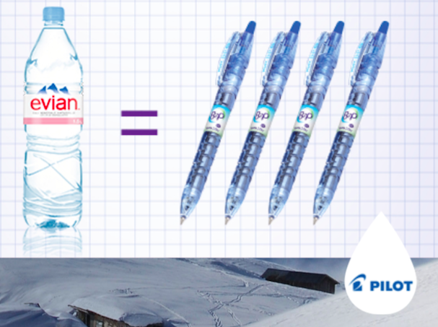
Réco machine
Insert your empty bottles
Receive a purchase voucher
1,5L Evian bottle= 4 plastic pens Pilot recycled
LemonTri machine

Slide 21
Objective: reach the target of zero net carbon
Evian = first brand of Danone which will reach this objective
Reduce greenhouse gases emissions

Slide 22
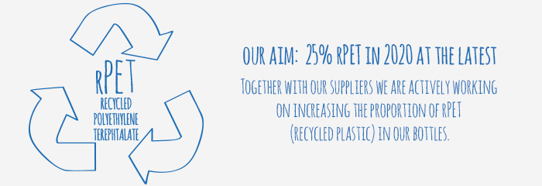
Objective: reach the target of zero net carbon
1) Packaging
PET (PolyEthylene Terephthalate) is an inert, air-tight and perfectly neutral material.
Since 1995
The PET is 100% recyclable.
rPET : Recycled PET
Final objective : 100 % plant-based plastic

Slide 23
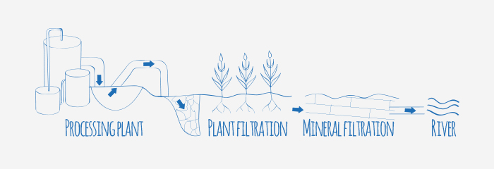
Objective: reach the target of zero net carbon
2) Production process
Reduce water consumption, energy and greenhouse gases emissions
Vegetal and mineral waste treatment
No chemical products

Slide 24
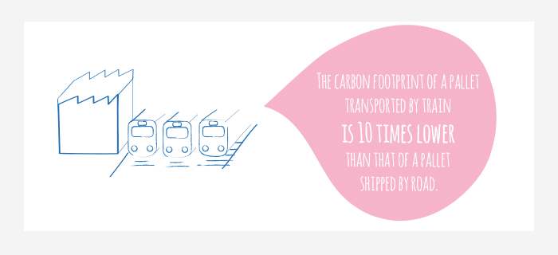
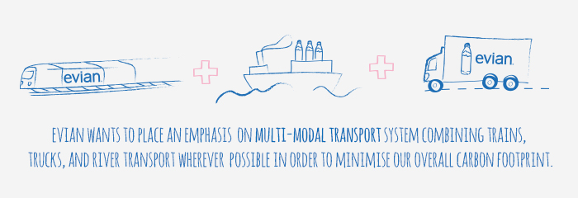
Objective: reach the target of zero net carbon
3) Shipping
60% shipped by train
Largest private rail station in France

Slide 25
Respect of the water cycle
Never takes more than what nature offers
Reasoned use of the source
Under the control of hydro-geologists
The source continues replenishing itself at a natural rate

Slide 26
Terragr’Eau
Transform the effluents of breeding into natural fertilizer and biogas.
This fertilizer guarantees a sustainable management of the territory around the source.
Triple virtue:
Protection of the water
Support of a successful agricultural activity
Renewable power production

Slide 27
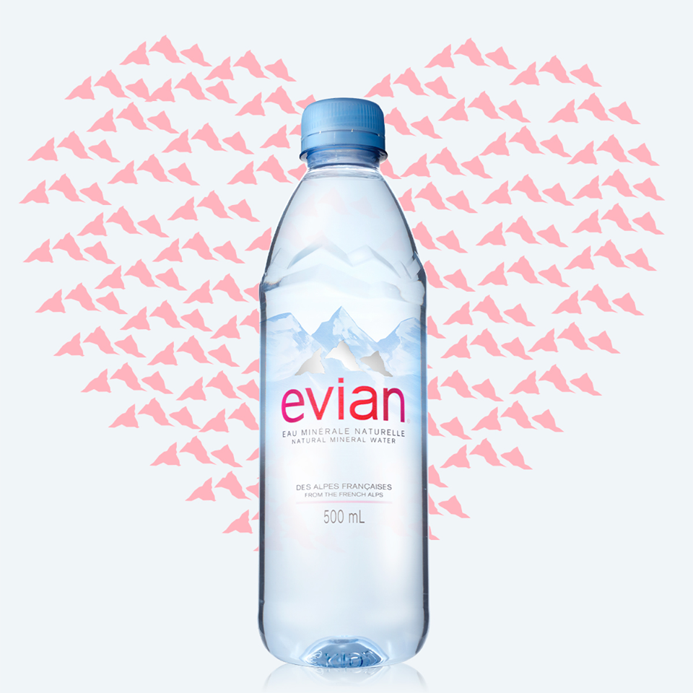
IX) Conclusion
Second biggest worldwide water company
Positive image
Diversification of products
Geographical expansion
Turnover growth
Respect of the environment
Objective 0 net carbon
Educate people to recycle bottles
Low emission shipping
Bottling with recycled raw materials
Danger of microplastic

Slide 28
BIBLIOGRAPHY
http://www.evian.com/en_us/
https://www.leaf.tv/articles/what-is-the-origin-of-evian-water/
https://ww.planetoscope.com/boisson/1284-production-mondiale-de-bouteilles-d-eau-d-evian.html
http://pure.evian.com/en/UK/
https://www.societe.com/societe/sa-eaux-minerales-evian-797080850.html
https://www.verif.com/bilans-gratuits/SA-EAUX-MINERALES-EVIAN-797080850/
https://www.youtube.com/watch?v=kzhiO9KqNvM
https://www.youtube.com/watch?v=nWFPMwlY7EA

Slide 29
Thank you for your attention, do you have any questions ?

